Slide 1
Internal Factors
Driven by changes from within the climate system itself
(Variability and Life)
Greenhouse Effect
Ocean Variability
Albedo

Slide 2
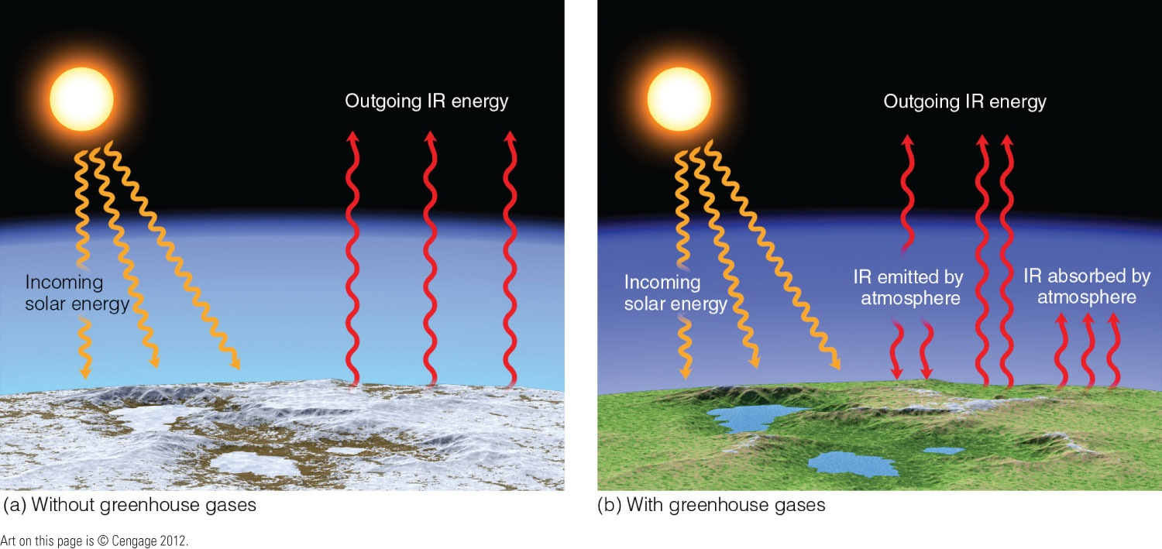
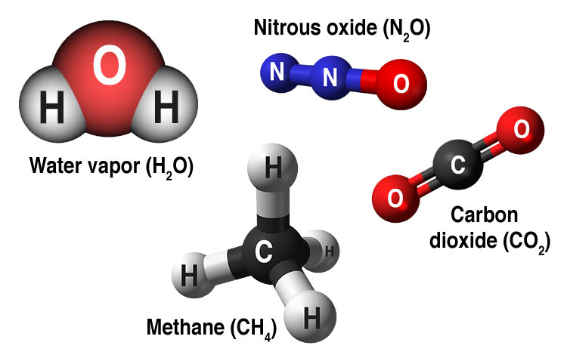
The Greenhouse Effect
The atmosphere absorbs radiation and emits it in every direction.
“Certain gases in the atmosphere block heat from escaping. Long-lived gases that remain semi-permanently in the atmosphere and do not respond physical or chemically to changes in temperature are described as “forcing” climate change. Gases, such as water vapor, which respond physically or chemically to changes in temperature are seen as “feedbacks”.”
Gases that contribute to the greenhouse effect include:
Water Vapor: The most abundant greenhouse gas, but importantly, it acts as a feedback to the climate. Water vapor increases as the Earth's atmosphere warms, but so does the possibility of clouds and precipitation, making these some of the most important feedback mechanisms to the greenhouse effect.
Chlorofluorocarbons (CFCs): Synthetic compounds entirely of industrial origin used in a number of applications, but now largely regulated in production and release to the atmosphere by international agreement for their ability to contribute to destruction of the ozone layer. They are also greenhouse gases.
Carbon dioxide (CO2): A minor but very important component of the atmosphere, carbon dioxide is released through natural processes such as respiration and volcano eruptions and through human activities such as deforestation, land use changes, and burning fossil fuels. Humans have increased atmospheric CO2 concentration by more than a third since the Industrial Revolution began. This is the most important long-lived "forcing" of climate change.
Methane: A hydrocarbon gas produced both through natural sources and human activities, including the decomposition of wastes in landfills, agriculture, and especially rice cultivation, as well as ruminant digestion and manure management associated with domestic livestock. On a molecule-for-molecule basis, methane is a far more active greenhouse gas than carbon dioxide, but also one which is much less abundant in the atmosphere.
Nitrous oxide: A powerful greenhouse gas produced by soil cultivation practices, especially the use of commercial and organic fertilizers, fossil fuel combustion, nitric acid production, and biomass burning.
https://climate.nasa.gov/causes/

Slide 3
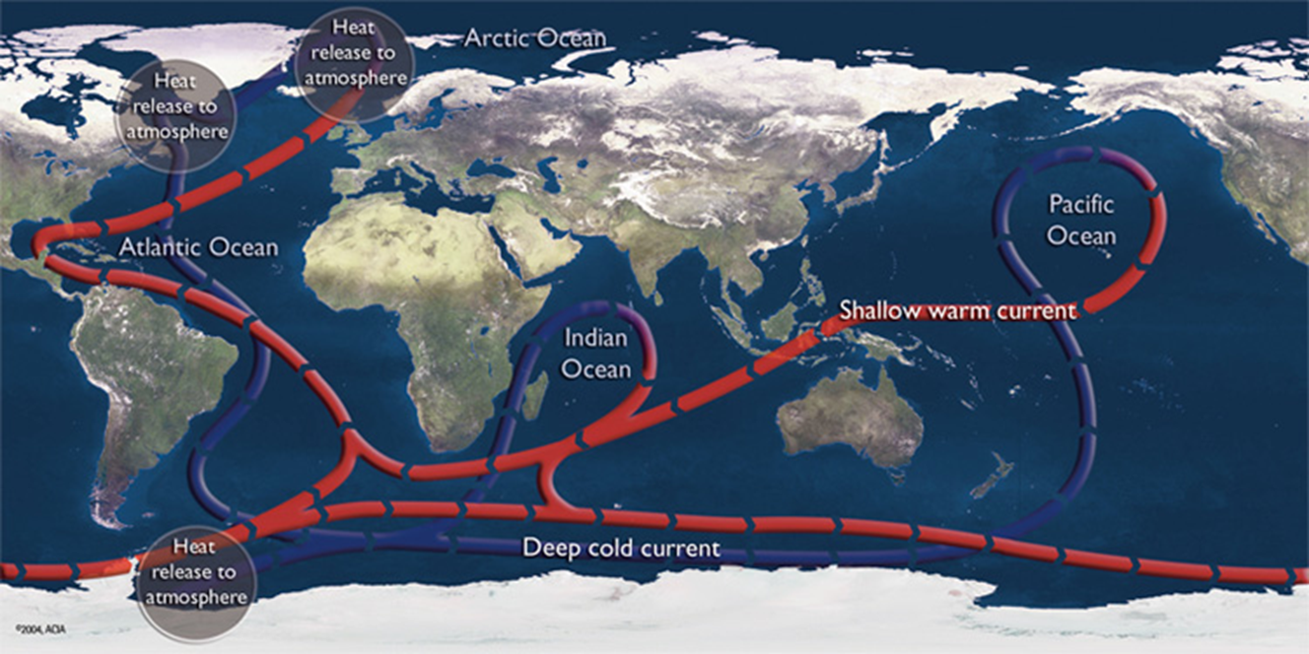
Ocean Variability – Thermohaline Circulation
“Winds drive ocean currents in the upper 100 meters of the ocean’s surface. However, ocean currents also flow thousands of meters below the surface. These deep-ocean currents are driven by differences in the water’s density, which is controlled by temperature (thermo) and salinity (haline). This process is known as the thermohaline circulation.
In the Earth’s polar regions ocean water gets very cold, forming sea ice. Consequently, the surrounding seawater gets saltier, because when the sea ice forms, the salt is left behind. As the seawater gets saltier, its density increases, and it starts to sink. Surface water is pulled in to replace the sinking water, which in turn eventually becomes cold and salty enough to sink. This initiates the deep-ocean currents driving the global conveyer belt.”
http://oceanservice.noaa.gov/education/tutorial_currents/05conveyor1.html

Slide 4



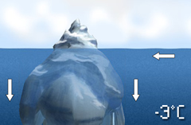
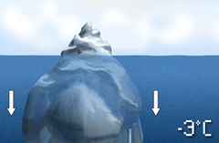
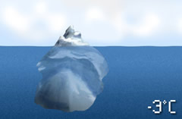
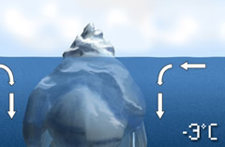
Ocean Variability – Thermohaline Circulation Continued
http://oceanservice.noaa.gov/education/tutorial_currents/05conveyor1.html

Slide 5
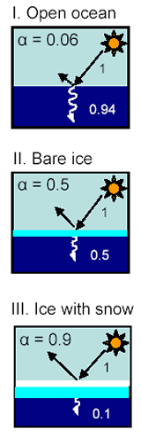
Albedo
“Albedo is a non-dimensional, unit-less quantity that indicates how well a surface reflects solar energy. Albedo (Î±) varies between 0 and 1. Albedo commonly refers to the “whiteness” of a surface, with 0 meaning black and 1 meaning white. A value of 0 means the surface is a “perfect absorber” that absorbs all incoming energy. Absorbed solar energy can be used to head the surface or, when sea ice is present, melt the surface. A value of 1 means the surface is a “perfect reflector” that reflects all incoming energy.
Albedo generally applies to visible light, although it may involve some of the infrared region of the electromagnetic spectrum. You understand the concept of low albedo intuitively when you avoid walking barefoot on blacktop on a hot summer day. Blacktop has a much lower albedo than concrete because the black surface absorbs more energy and reflects very little energy.
Sea ice has a much higher albedo compared to other Earth surfaces, such as the surrounding ocean. A typical ocean albedo is approximately 0.06, while bare sea ice varies from approximately 0.5 to 0.7. This means that the ocean reflects only 6% of the incoming solar radiation and absorbs the rest, while sea ice reflects 50% to 70% of the incoming energy. The sea ice absorbs less solar energy and keeps the surface cooler.
Snow has an even higher albedo than sea ice, and so thick sea ice covered with snow reflects as much as 90% of the incoming solar radiation. This serves to insulate the sea ice, maintaining cold temperatures and delaying ice melt in the summer. After the snow does begin to melt, and because shallow melt ponds have and albedo of approximately 0.2 to 0.4, the surface albedo drops to about 0.75. As melt ponds grow and deepen, the surface albedo can drop to 0.15. As a result, melt ponds are associated with higher energy absorption and a more rapid ice melt.”
https://nsidc.org/cryosphere/seaice/processes/albedo.html

Slide 6
External Factors
Driven by forces from outside the climate system
(Earth in Space and Humans)
Orbital Variation
Solar Cycle
Aerosols

Slide 7
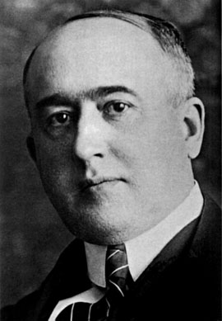
Orbital Variations – The Milankovitch Theory
“The Milankovitch Theory
Milankovitch dedicated his career to developing a mathematical theory of climate based on the seasonal and latitudinal variations of solar radiation received by the Earth. Now known as the Milankovitch Theory, it states that as the Earth travels through space around the sun, cyclical variations in three elements of Earth-sun geometry combine to produce variations in the amount of solar energy that reaches Earth:
Variations in the Earth’s orbital eccentricity – the shape of the orbit around the sun
Changes in obliquity – changes in the angle that Earth’s axis makes with the plane of the Earth’s orbit
Precession – the change in the direction of the Earth’s axis of rotation, i.e., the axis of rotation behaves like the spin axis of a top that is winding down; hence it traces a circle on the celestial sphere over a period of time.
Together, the periods of these orbital motions have become known as Milankovitch cycles.”
http://www.mi.sanu.ac.rs/History/images/14.jpg
https://earthobservatory.nasa.gov/Features/Milankovitch/

Slide 8
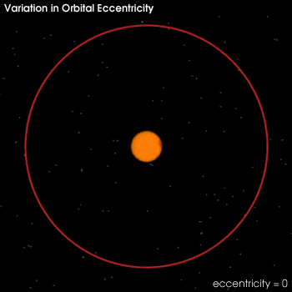
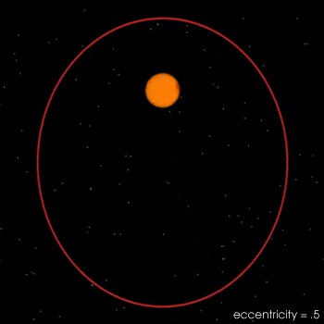
Orbital Variations – Eccentricity
“Changes in orbital eccentricity affect the Earth-sun distance. Currently, a difference of only 3 percent (5 million kilometers) exists between closest approach (perihelion), which occurs on or about January 3, and furthest departure (aphelion), which occurs on or about July 4. This difference in distance amounts to about a 6 percent increase in incoming solar radiation (insolation) from July to January. The shape of the Earth’s orbit changes from being elliptical (high eccentricity) to being nearly circular (low eccentricity) in a cycle that takes between 90,000 and 100,000 years. When the orbit is highly elliptical, the amount of insolation received at perihelion would be on the order of 20 to 30 percent greater than at aphelion, resulting in a substantially different climate from what we experience today.”
“The eccentricity of the Earth's orbit changes slowly over time from nearly zero to 0.07. As the orbit gets more eccentric (oval) the difference between the distance from the Sun to the Earth at perihelion (closest approach) and aphelion (furthest away) becomes greater and greater. Note that the Sun is not at the center of the Earth's orbital ellipse, rather it is at one of focal points.”
“Note: The eccentricity of the orbit shown in the image above is a highly exaggerated 0.5. Even the maximum eccentricity of the Earth's orbit—0.07—it would be impossible to show at the resolution of a web page. Even so, at the current eccentricity of .017, the Earth is 5 million kilometers closer to Sun at perihelion than at aphelion. (Images by Robert Simmon, NASA GSFC)”
https://earthobservatory.nasa.gov/Features/Milankovitch/

Slide 9
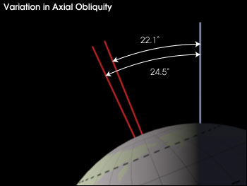
Orbital Variations – Obliquity (Change in Axial Tilt)
“As the axial tilt increases, the seasonal contrast increases so that winters are colder and summers are warmer in both hemispheres. Today, the Earth's axis is tilted 23.5 degrees from the plane of its orbit around the sun. But this tilt changes. During a cycle that averages about 40,000 years, the tilt of the axis varies between 22.1 and 24.5 degrees. Because this tilt changes, the seasons as we know them can become exaggerated. More tilt means more severe seasons—warmer summers and colder winters; less tilt means less severe seasons—cooler summers and milder winters. It's the cool summers that are thought to allow snow and ice to last from year-to-year in high latitudes, eventually building up into massive ice sheets. There are positive feedbacks in the climate system as well, because an Earth covered with more snow reflects more of the sun's energy into space, causing additional cooling.”
“The change in the tilt of the Earth's axis (obliquity) effects the magnitude of seasonal change. At higher tilts the seasons are more extreme, and at lower tilts they are milder. The current axial tilt is 23.5°. Image by Robert Simmon, NASA GSFC)”
https://earthobservatory.nasa.gov/Features/Milankovitch/

Slide 10
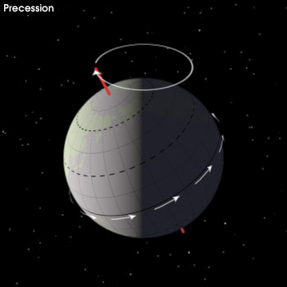
Orbital Variations – Precession
“Precession—the change in orientation of the Earth's rotational axis [can be seen more clearly here: https://www.youtube.com/watch?v=Dw4Xhw4q4ec] alters the orientation of the Earth with respect to perihelion and aphelion. If a hemisphere is pointed towards the sun at perihelion, that hemisphere will be pointing away at aphelion, and the difference in seasons will be more extreme. This seasonal effect is reversed for the opposite hemisphere. Currently, northern summer occurs near aphelion. (Image by Robert Simmon, NASA GSFC)”
“Changes in axial precession alter the dates of perihelion and aphelion, and therefore increase the seasonal contrast in one hemisphere and decrease the seasonal contrast in the other hemisphere.”
https://earthobservatory.nasa.gov/Features/Milankovitch/

Slide 11
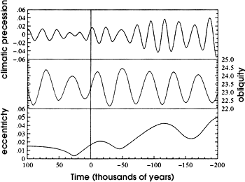
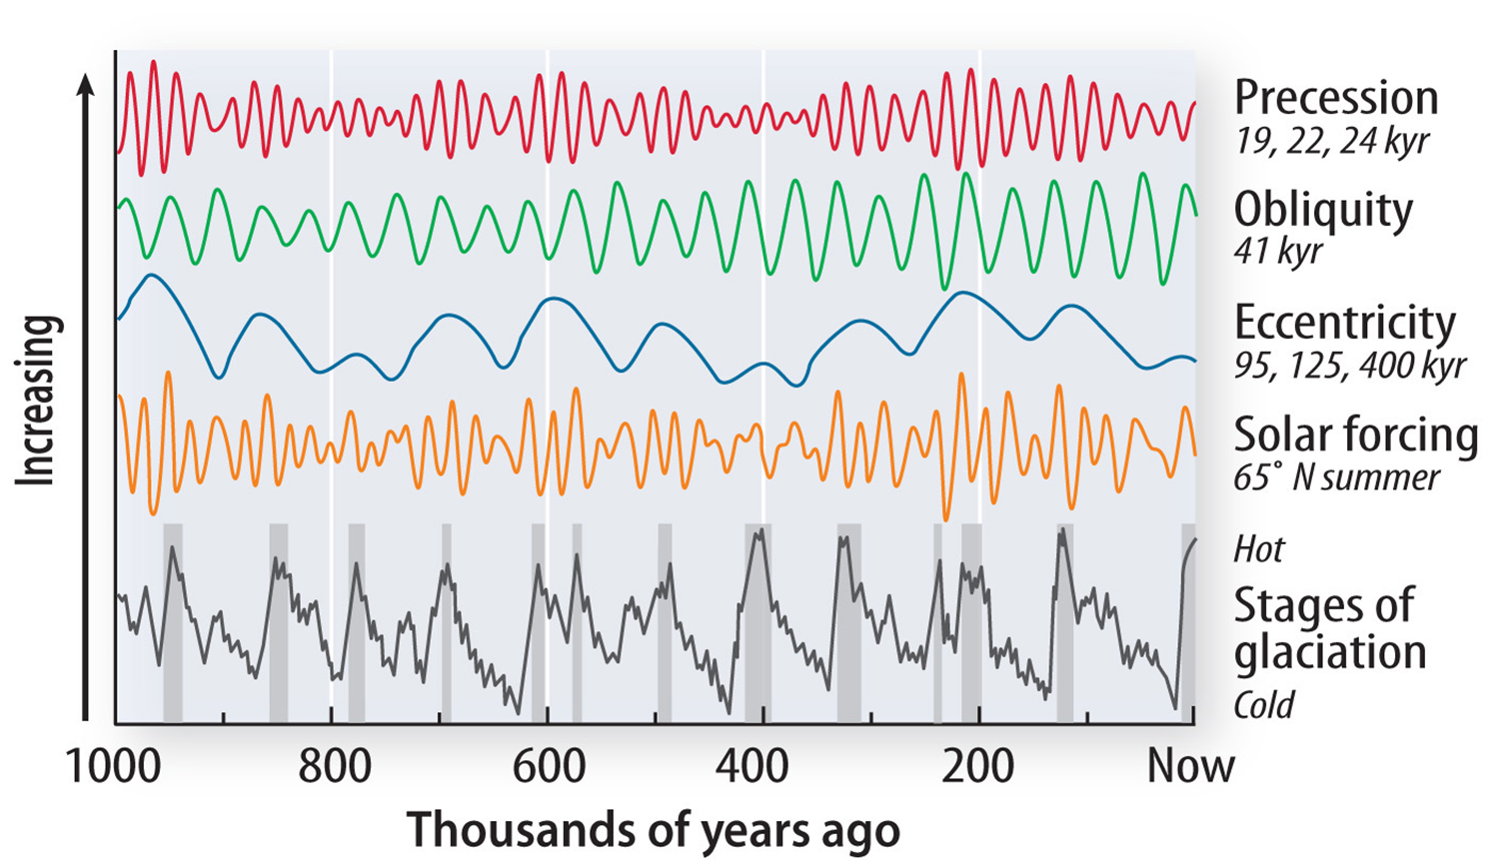
Orbital Variations – The Milankovitch Theory: How it Works
Left: “These graphs show calculated values for 300,000 years of orbital variation. The line labeled "0" represents today, while "-200" indicates 200,000 years in the past and "100" indicates 100,000 years from now. Milankovitch noticed that these cycles of orbital mechanics correspond to many indicators of past climate change, such as Ice Ages. (From Berger and Loutre, 1991)”
“Using these three orbital variations, Milankovitch was able to formulate a comprehensive mathematical model that calculated latitudinal differences in insolation and the corresponding surface temperature for 600,000 years prior to the year 1800. He then attempted to correlate these changes with the growth and retreat of the Ice Ages. To do this, Milankovitch assumed that radiation changes in some latitudes and seasons are more important to ice sheet growth and decay than those in others. Then, at the suggestion of German Climatologist Vladimir Koppen, he chose summer insolation at 65 degrees North as the most important latitude and season to model, reasoning that great ice sheets grew near this latitude and that cooler summers might reduce summer snowmelt, leading to a positive annual snow budget and ice sheet growth.”
“But, for about 50 years, Milankovitch's theory was largely ignored. Then, in 1976, a study published in the journal Science examined deep-sea sediment cores and found that Milankovitch's theory did in fact correspond to periods of climate change (Hays et al. 1976). Specifically, the authors were able to extract the record of temperature change going back 450,000 years and found that major variations in climate were closely associated with changes in the geometry (eccentricity, obliquity, and precession) of Earth's orbit. Indeed, ice ages had occurred when the Earth was going through different stages of orbital variation.”
“Since this study, the National Research Council of the U.S. National Academy of Sciences has embraced the Milankovitch Cycle model.”
“...orbital variations remain the most thoroughly examined mechanism of climatic change on time scales of tens of thousands of years and are by far the clearest case of a direct effect of changing insolation on the lower atmosphere of Earth (National Research Council, 1982).”
https://earthobservatory.nasa.gov/Features/Milankovitch/

Slide 12
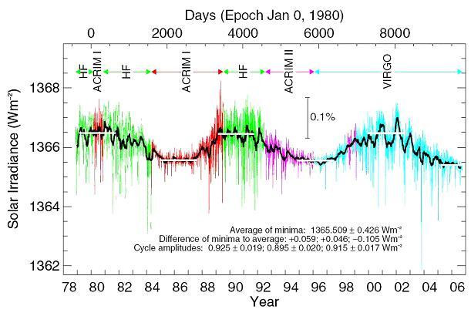
Solar Cycle
Record of Minimal Variation in Sun’s Energy
“The rate of energy coming from the sun changes slightly day to day. Over many millennia in the Earth-Sun orbital relationship can change the geographical distribution of the sun’s energy over the Earth’s surface. It has been suggested that changes in solar output might affect our climate—both directly, by changing the rate of solar heating of the Earth and atmosphere, and indirectly, by changing cloud forming processes.
Over the time-scale of millions of years the change in solar intensity is a critical factor influencing climate (e.g., ice ages). However, changes in solar heating rate over the last century cannot account for the magnitude and distribution of the rise in global mean temperature during that time period and there is no convincing evidence for significant indirect influences on our climate due to twentieth century changes in solar output.”
“Total Solar Irradiance.”
“Total Solar Irradiance (TSI) is the rate at which energy from the sun reaches the top of Earth’s atmosphere. TSI fluctuates slightly from day to day and week to week. Superimposed on these rapid short-term fluctuations is a cycle related to sunspots in the outer layers of the Sun that lasts approximately every 11 years.”
Above: “Two and a half solar cycles of Total Solar Irradiance (TSI), also called ‘solar constant’. This composite, compiled by the VIRGO team at the Physikalisch-Meteorologisches Observatorium / World Radiation Center Davos, Switzerland, shows TSI as daily values plotted in different colors for the different originating experiments. The difference between the minima values is also indicated, together with amplitudes of the three cycles.” Image courtesy of SOHO Consortium a project of international cooperation between ESA and NASA.”
http://www.ucsusa.org/global_warming/science_and_impacts/science/effect-of-sun-on-climate-faq.html#.WQ-1YuXyuUk

Slide 13
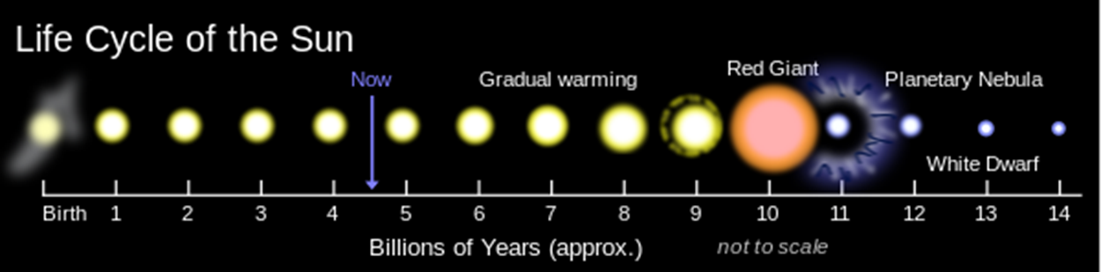
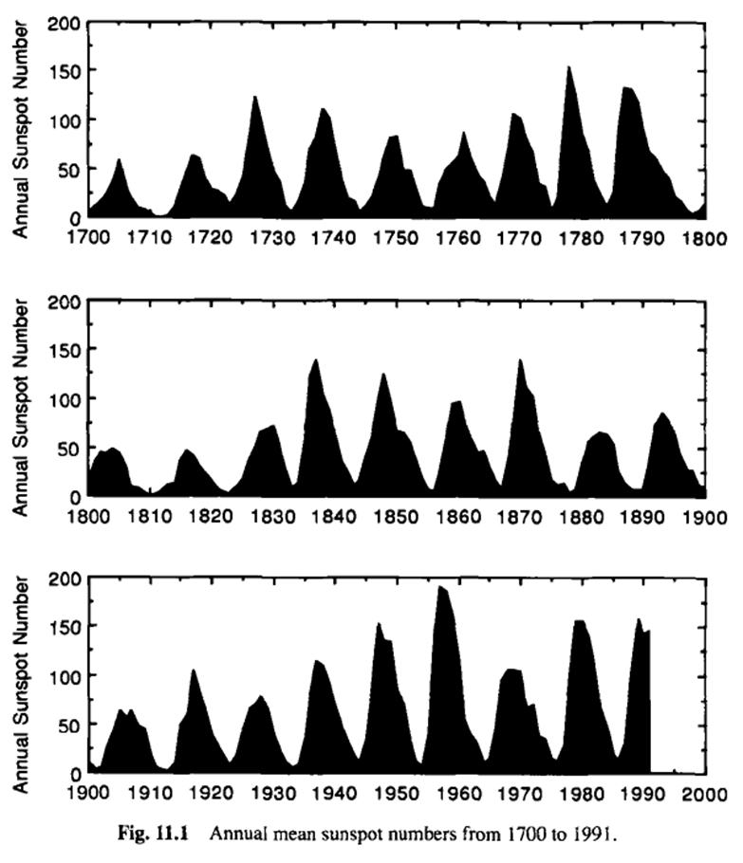
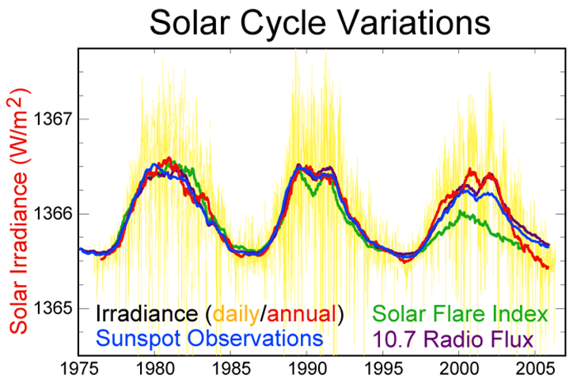
Solar Cycle Continued
The higher number of sunspots correlates to a higher intensity sun. Which means the more sunspots located on the sun, the more radiation the sun emits.
Annual Number of Sunspots 1700-1990
By comparing the two graphs pictured, looking at 1975-1990, the number of sunspots directly correlates to the Solar Irradiance. 1975 and 1985 recorded around 25 sunspots with a Solar Irradiance of about 1365.6, while 1980 and 1990 recorded around 150 sunspots with a Solar Irradiance of about 1366.6.

Slide 14
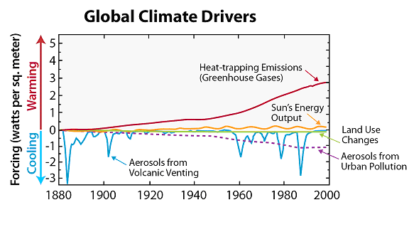
Solar Variations Related to the Twentieth Century Climate
“The rate at which solar energy reaches the Earth’s surface in any location depends on the season, time of day, cloudiness and the concentration of small aerosol particles in the atmosphere. During the late twentieth century, the average amount of solar energy reaching the surface decreased slightly due to atmospheric particles (aerosols), particularly in urban locations, that reflect the sun’s energy back into space. This pollution did not cause net global cooling because it was more than counteracted by the increasing concentrations of heat- trapping gases in the atmosphere (Greenhouse Effect).
In its Fourth Assessment Report, IPCC scientists evaluated simulations of twentieth century climate variables using a number of numerical models. They first assumed no increase in heat-trapping gases over this period, so that the temperatures calculated were those that would have been achieved if only solar variability, volcanic eruptions, and other natural climate drivers were included. The temperature results were similar to observed temperatures only for the first half of the century, but the models did not accurately show the general warming trend that has been recorded during the second half of the twentieth century. However, when the human-induced heat-trapping gases were included in the computer model, it accurately reproduced the observed warming during the twentieth century.
Thus, although fluctuations in the amount of solar energy reaching our atmosphere do influence our climate, the global warming trend of the past six decades cannot be attributed to changes in the sun.”
Twentieth Century History of Climate Drivers
Above: “Heat-trapping emissions (greenhouse gases) far outweigh the effects of other drivers acting on Earth’s climate.”
http://www.ucsusa.org/global_warming/science_and_impacts/science/effect-of-sun-on-climate-faq.html#.WQ-1YuXyuUk

Slide 15
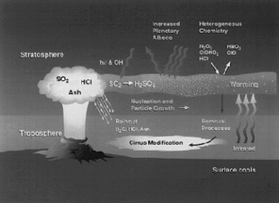
Aerosols
Left: “The dispersal of volcanic aerosols has a drastic effect on Earth's atmosphere. Follow an eruption, large amounts of sulphur dioxide (SO2), hydrochloric acid (HCL) and ash are spewed into Earth's stratosphere. HCL, in most cases, condenses with water vapor and is rained out of the volcanic cloud formation. SO2 from the cloud is transformed into sulphuric acid, H2SO4. The sulphuric acid quickly condenses, producing aersol particles which linger in the atmosphere for long periods of time. The interaction of chemicals on the surface of aerosols, known as heterogeneous chemistry, and the tendency of aerosols to increase levels of chlorine gas react with nitrogen in the stratopshere, is a prime contributor to stratospheric ozone destruction.
Credits: NASA.”
“Aerosols are minute particles suspended in the atmosphere. When these particles are sufficiently large, we notice their presence as they scatter and absorb sunlight. Their scattering of sunlight can reduce visibility (haze) and redden sunrises and sunsets.
Aerosols interact both directly and indirectly with the Earth's radiation budget and climate. As a direct effect, the aerosols scatter sunlight directly back into space. As an indirect effect, aerosols in the lower atmosphere can modify the size of cloud particles, changing how the clouds reflect and absorb sunlight, thereby affecting the Earth's energy budget.
Aerosols also can act as sites for chemical reactions to take place (heterogeneous chemistry). The most significant of these reactions are those that lead to the destruction of stratospheric ozone. During winter in the polar regions, aerosols grow to form polar stratospheric clouds. The large surface areas of these cloud particles provide sites for chemical reactions to take place. These reactions lead to the formation of large amounts of reactive chlorine and, ultimately, to the destruction of ozone in the stratosphere. Evidence now exists that shows similar changes in stratospheric ozone concentrations occur after major volcanic eruptions, like Mt. Pinatubo in 1991, where tons of volcanic aerosols are blown into the atmosphere.”
There are three types of Aerosols:
Volcanic Aerosols
Desert Dust
Human-Made Aerosols
https://www.nasa.gov/centers/langley/news/factsheets/Aerosols.html

Slide 16
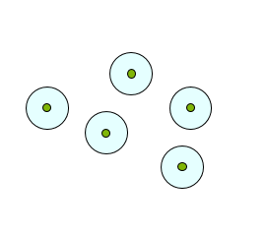
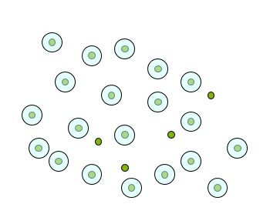
Aerosol “Indirect Effect”
Clouds form by condensation on preexisting aerosol particles (“cloud condensation nuclei”) when RH > 100%
Clean Cloud (Few Particles): Large Cloud Droplets
Polluted Cloud (Many Particles): Small Cloud Droplets
Clean clouds have a low albedo and efficient precipitation
Polluted clouds have a high albedo and suppressed precipitation
SUNY Plattsburgh, ENV366A – Global Climate Change – Spring 2017 (Eric Leibensperger), Lecture 05, Week of February 6th, 2017 – February 12th, 2017

Slide 17
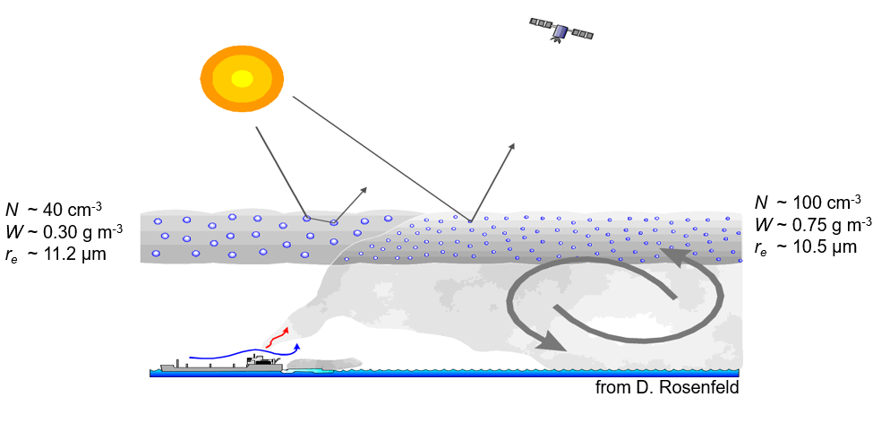
Evidence of the Aerosol Indirect Effect
Particles emitted by ships increase the concentration of cloud condensation nuclei (CCN).
Increased CCN increases the concentration of cloud droplets and reduce their average size.
Increased concentration and smaller particles reduce the production of drizzle.
Liquid water content increases because the loss of drizzle particles is suppressed.
Clouds are optically thicker and brighter along the ship track.
SUNY Plattsburgh, ENV366A – Global Climate Change – Spring 2017 (Eric Leibensperger), Lecture 05, Week of February 6th, 2017 – February 12th, 2017

Slide 18
Climate vs Weather Sources

Slide 19
Whole Thing
https://www.nasa.gov/mission_pages/noaa-n/climate/climate_weather.html

Slide 20
Myths Page Sources

Slide 21
Climate Myths vs What the Science Says Table
https://www.skepticalscience.com/argument.php
Pros and Cons
http://climatechange.procon.org/

